Slide 1
EXECUTIVE REPORT | WINE RECOMMENDATION
Executive Summary
178
Wines in catalog
13
Chemical attributes
3
Cultivars
93%
Avg precision@5
METHOD
Every wine's 13 lab-measured chemical attributes (alcohol, phenols, color intensity, proline, etc.) are standardized, then compared pairwise with cosine similarity.
Given a wine a taster likes, a K-Nearest Neighbors lookup finds the closest matches in that standardized space -- no other tasters or ratings required, unlike collaborative filtering.
Precision@5 validates the approach: it checks whether a wine's nearest neighbors actually share its cultivar (its real, known style), using the dataset's ground-truth labels.
K-Nearest Neighbors | Cosine Similarity on Chemical Profile
01/04

Slide 2
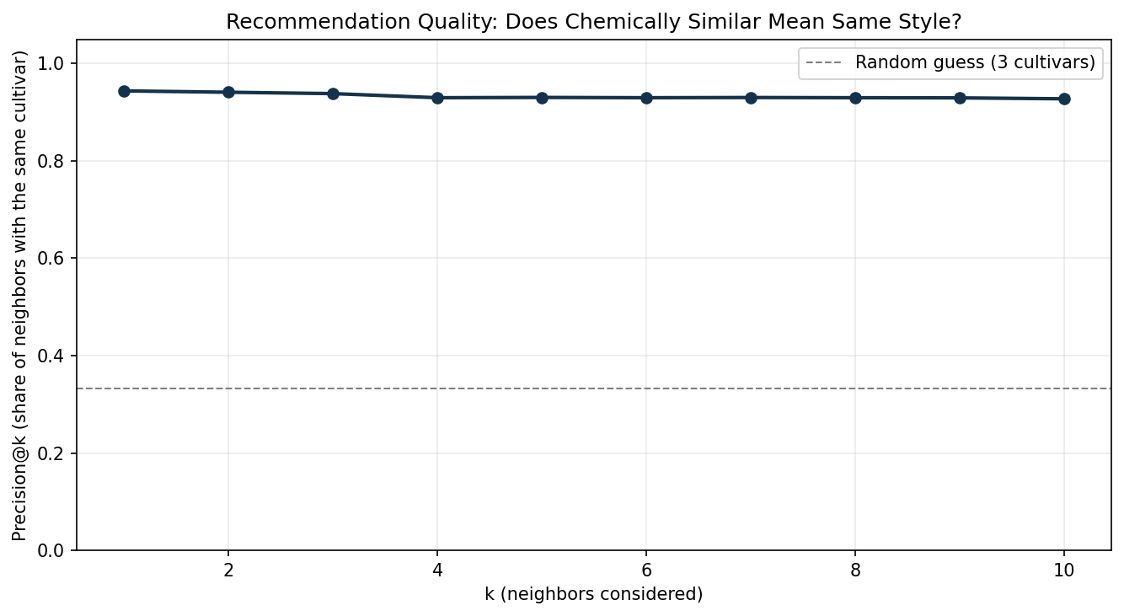
EXECUTIVE REPORT | WINE RECOMMENDATION
Recommendation Quality
PRECISION@K -- DOES 'CHEMICALLY SIMILAR' MEAN 'SAME STYLE'?
K-Nearest Neighbors | Cosine Similarity on Chemical Profile
02/04

Slide 3
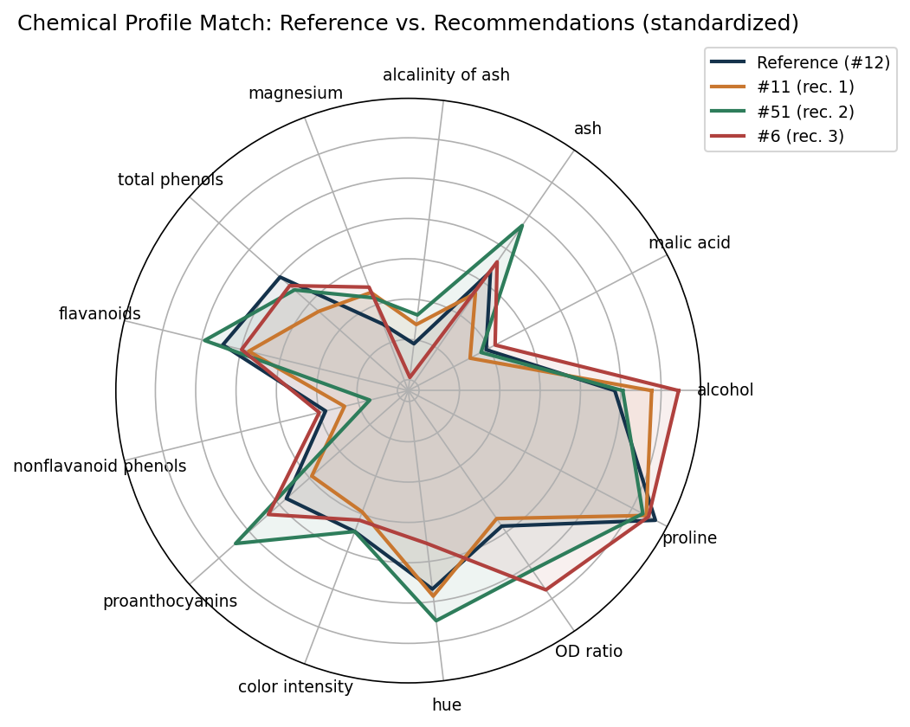
EXECUTIVE REPORT | WINE RECOMMENDATION
Sample Recommendation
REFERENCE: Wine #12 (Cultivar 0) -- CHEMICAL PROFILE MATCH
TOP RECOMMENDATIONS
Wine
Cultivar
Similarity
Wine #11
0
0.911
Wine #51
0
0.892
Wine #6
0
0.883
Wine #14
0
0.861
Wine #10
0
0.855
K-Nearest Neighbors | Cosine Similarity on Chemical Profile
03/04

Slide 4
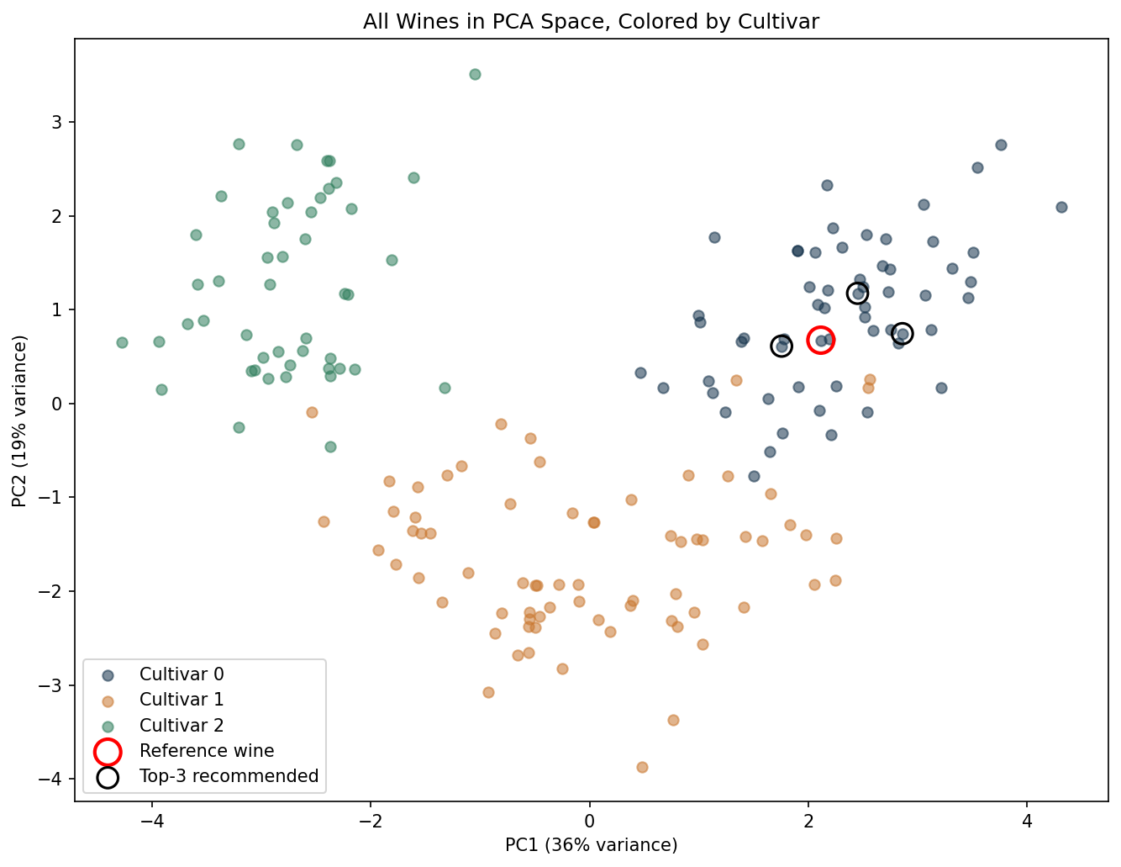
EXECUTIVE REPORT | WINE RECOMMENDATION
Similarity Landscape
ALL WINES IN PCA SPACE, COLORED BY CULTIVAR
K-Nearest Neighbors | Cosine Similarity on Chemical Profile
04/04

